Slide 1
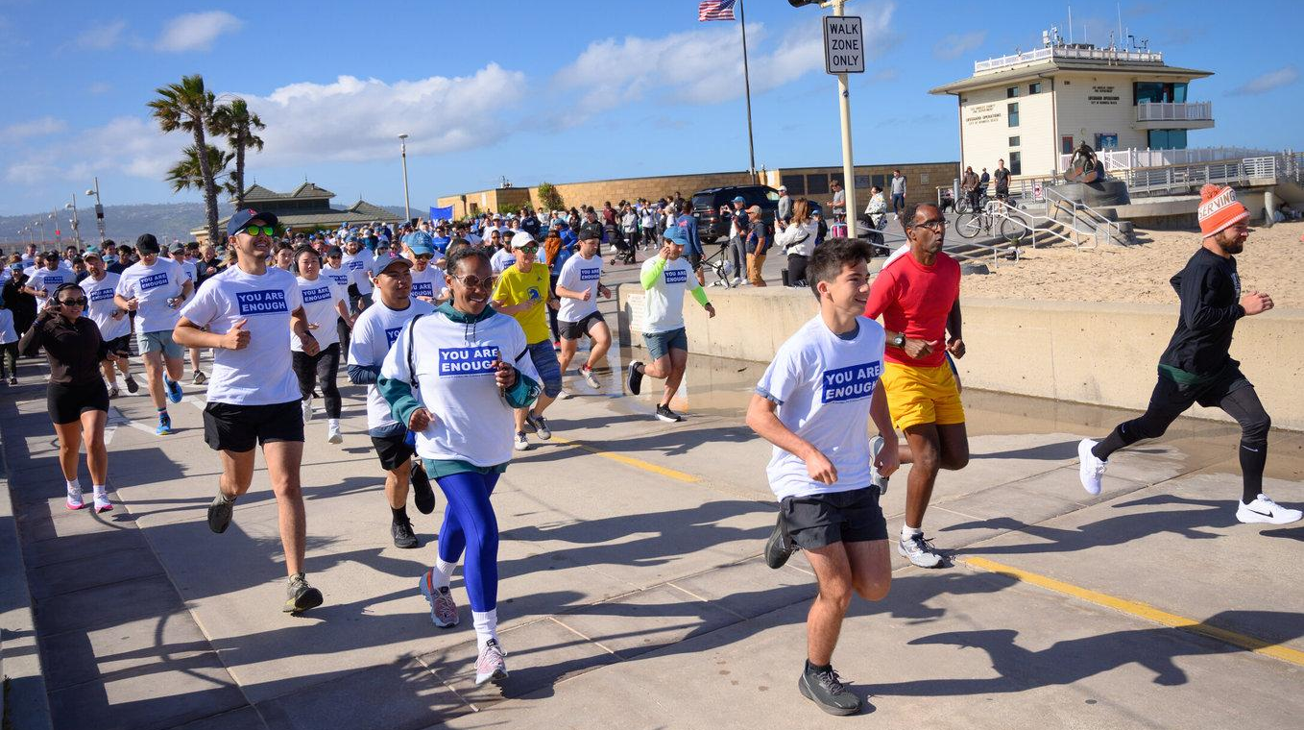
TAKING
YOU ARE ENOUGH
TO THE NEXT LEVEL
Prepared by Giving Purpose Organization
February 2026
EIN - 85-3745752

Slide 2
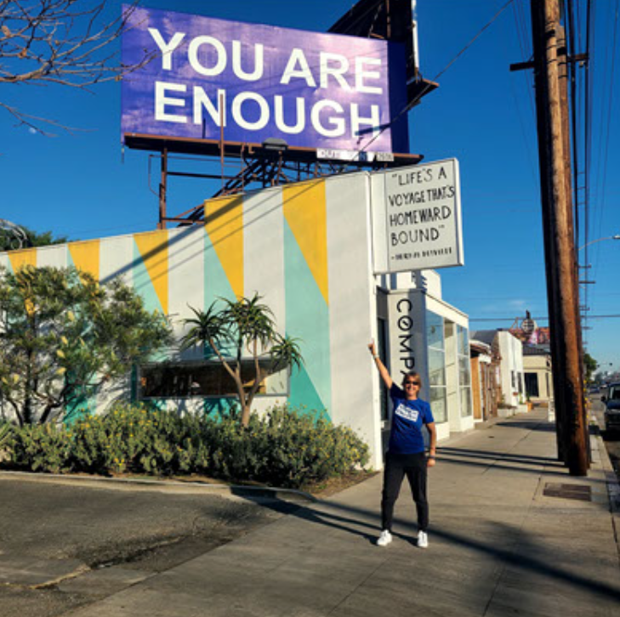

MISSION
Provide mental wellness campaigns to help people feel worthy, seen, and supported.

Slide 3
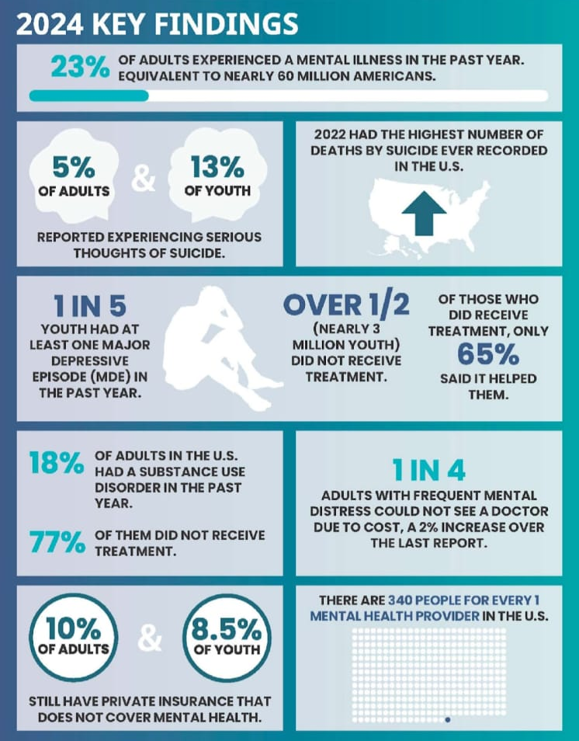
IT’S TIME TO UNITE TO HEAL AROUND MENTAL HEALTH.
Source – Menta Health America

Slide 4
LOS ANGELES SUICIDE RATES - 2023
FOR ALL AGES
FOR YOUTH AGES
8th
leading cause of premature death
among Los Angeles County residents
829
suicide deaths
the age-adjusted rate of suicide deaths was 7.6 per 100,000 residents
3,399
non-fatal suicide attempts
among Los Angeles County residents treated in California hospitals or emergency departments
33%
of suicide deaths involved a firearm
270 total suicide deaths in Los Angeles County
3rd
leading cause of premature death
among Los Angeles County residents
102
youth suicide deaths
the age-adjusted rate of youth suicide deaths was 5.3 per 100,000 residents
1502
non-fatal suicide attempts
among Los Angeles County residents treated in California hospitals or emergency departments
19
of suicide deaths involved a firearm
among Los Angeles County youth

Slide 5

INTRODUCING
YOU ARE ENOUGH
for Societal Healing
The flagship Giving Purpose Organization mental wellness campaign founded in April 2020 by Cathy Caplener.
Mission - Provide “Share it Forward” societal healing campaigns featuring the words YOU ARE ENOUGH via billboards, merchandise, and events.
Empowering YOU To HELP others feel worthy, seen, and supported

Slide 6
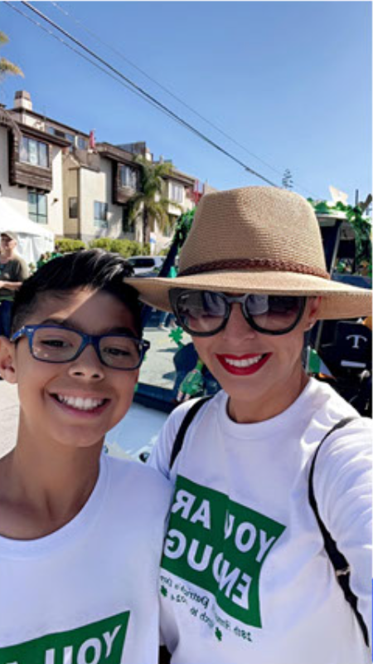
TARGET AUDIENCE
The South Bay of Los Angeles, LA County, and the United States.
LGBTQ, veteran, senior, disabled, people of color, and underserved communities.
South Bay businesses including schools, churches, adoption agencies, recovery, disabled, and homeless centers.
We All Need To Feel Worthy!

Slide 7
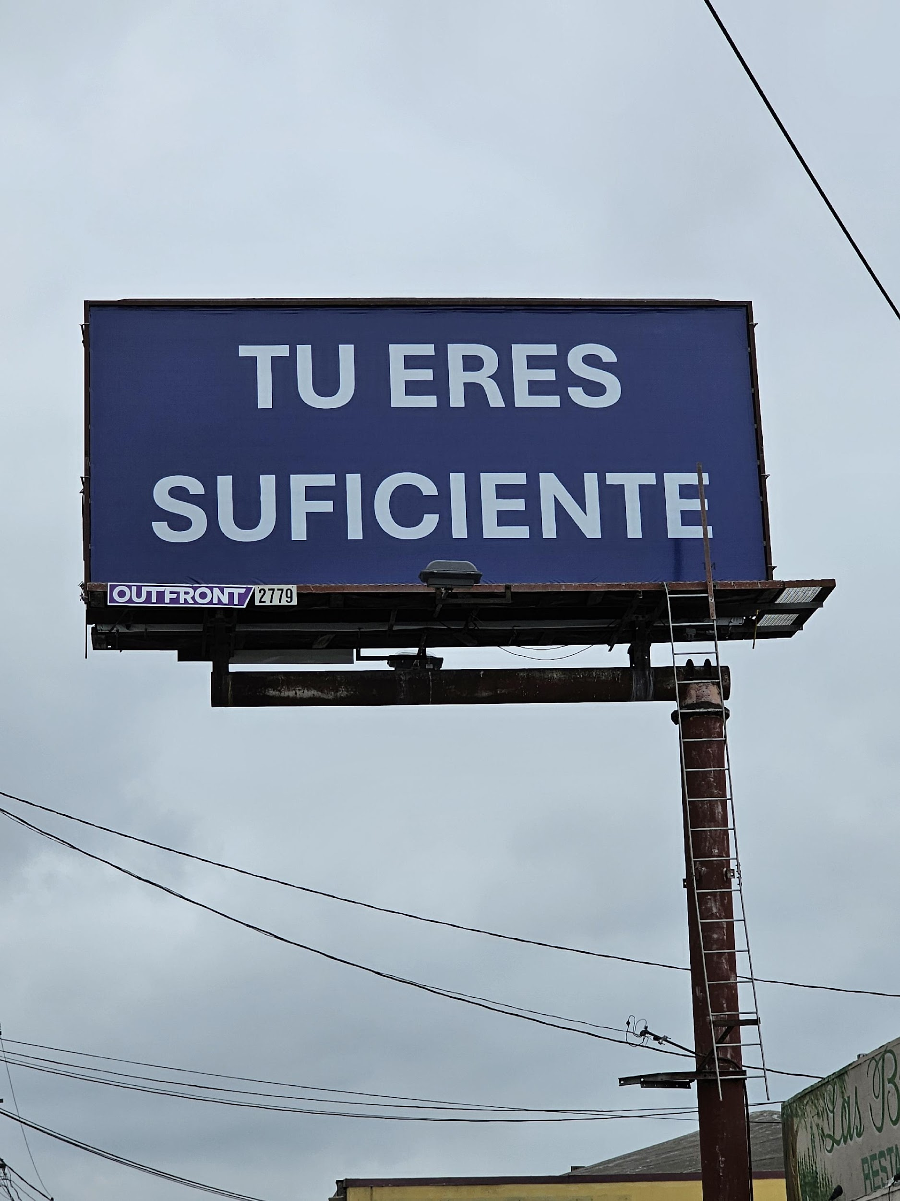
OUR PROGRESS
Improving And Saving Lives
Launched 2500 billboards nationwide
Successfully organized two, YOU ARE ENOUGH, 5Ks
Received $100,000 in donations
Awarded a $50,000 grant from the LA County Department of Mental Health annual Take Action LA campaign.
Teamed up with major sponsors including Skechers, and Kinecta. Credit Union, Murad, Jersey Mike’s Subs, and Raising Cane’s.
Notes:
Launched 2500 billboards nationwide
Successfully organized two, YOU ARE ENOUGH, 5Ks
Received $100,000 in donations
Awarded a $50,000 grant from the LA County Department of Mental Health annual Take Action LA campaign.
Teamed up with major sponsors including Skechers, Kinecta Credit Union, Murad, Jersey Mike’s Subs, and Raising Cane’s.

Slide 8
Billboard Impressions
1
Campaign Gear Distribution/Sales
3
60 million – Lamar Advertising nationwide PSA campaign
3 million – Pride billboard
1 million – Spanish billboard
2 million – 5K billboard
15 million – Campaign flagship South Bay billboards
*10 lives saved (documented)
(SEE DEMOGRAPHICS FOR SOUTHBAY BILLBOARDS IN APPENDIX)
10,000 wristbands
300 yard signs
300 t-shirts
100 hoodies
500 hats
500 license plate holders
Volunteer Program
Merchandise Hand-Outs
4
2
100 volunteers
5Ks – 1000 participants (bags, shirts, wristbands, stickers, license plates, hats)
1000 t-shirts/wristbands at Inglewood LA County Department of Mental Health Take Action LA campaign with 3000 in attendance
10,000 wristbands at Skechers Friendship Walk 2023 with 20,000 in attendance
*Note – The Spanish community has purchased the most merchandise
Mailing List
5
1100

Slide 9
2025 GOALS
Why We Need Your Help
Launch a billboard in every state capital during 2025 May Mental Health Awareness Month.
Team up with Redondo Union High School, Fusion Academy, and Inglewood High School.
Triple the YOU ARE ENOUGH 5K attendance to 1,000.
Hold five, YOU ARE ENOUGH 5K, virtual walks throughout Los Angeles county.
Sell merchandise at big-box stores.
Create an influencer program.
Hold a YOU ARE ENOUGH day in the South Bay.
Launch a Hermosa Pride Billboard
Team up with LA County Department of Mental Health for Mental Health Awareness Month

Slide 10
HELP US EVOLVE
Donate
Host a fundraiser
1
4
Become a sponsor
Sponsor a billboard with your name on it
2
5
Partner with us on YOU ARE ENOUGH events
Volunteer
3
6

Slide 11






TEAM UP WITH YOU ARE ENOUGH
Decrease mental health stigma.
Be a part of a nationwide movement
Expand the campaign across LA County and the United States.
Become a mental health advocate and conduit.
Improve the mental health of your community.
Heal while helping others

Slide 12
2026 BUDGET -$110,000
$100,000
$10,000
$5,000
United States Billboard campaign
YOU ARE ENOUGH 5K
Merchandise in big-box stores
$5,000
$5,000
$150,000
LA County 5K walks
Miscellaneous marketing fees
Annual Operational costs

Slide 13
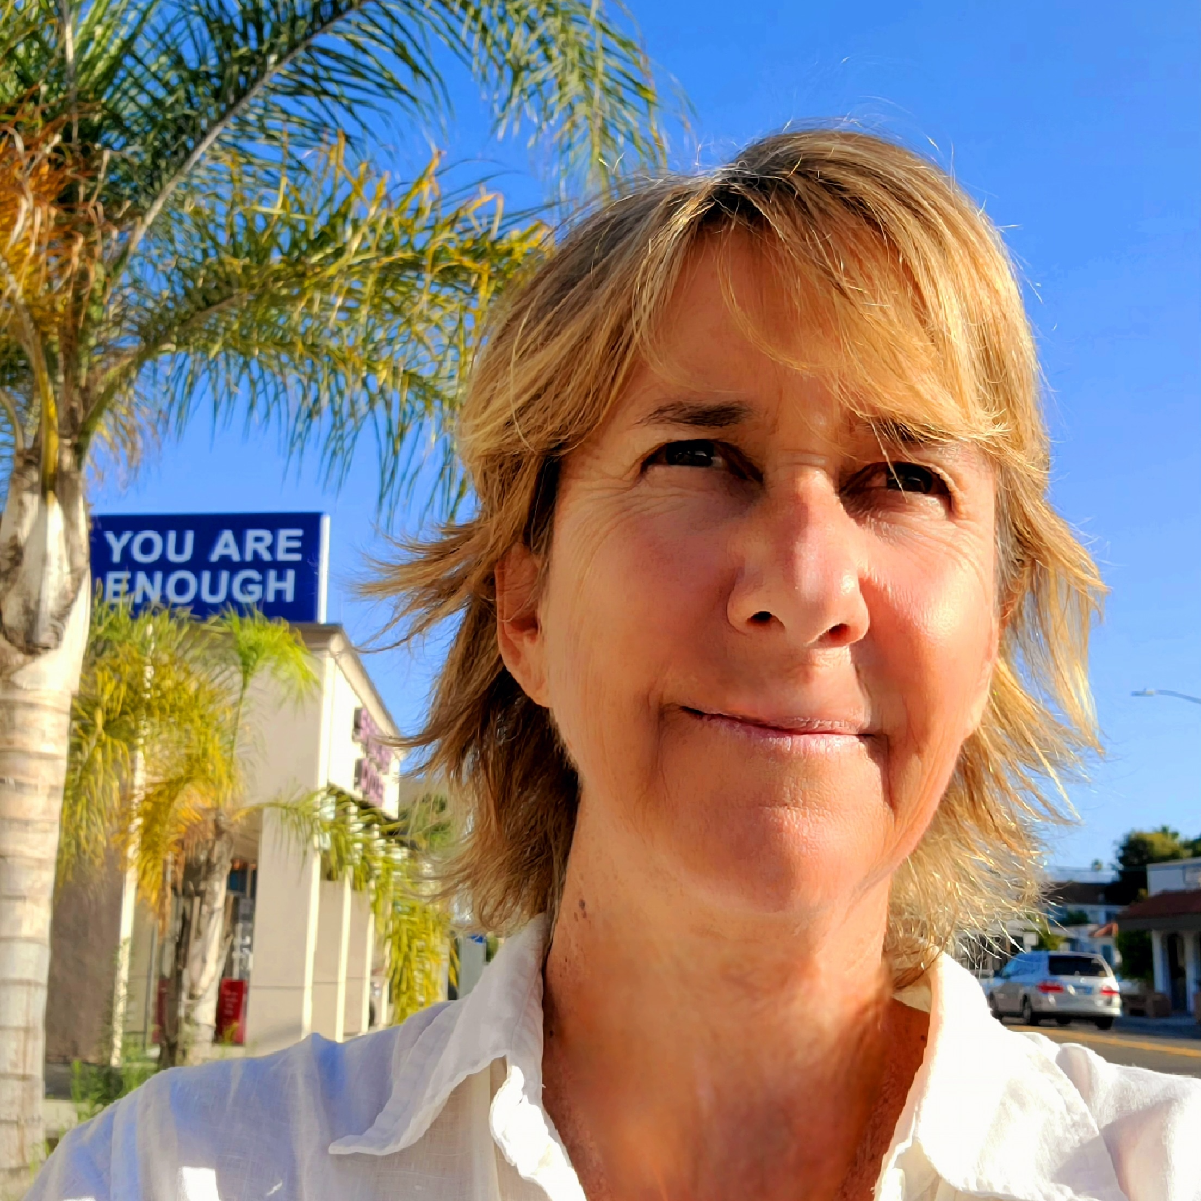
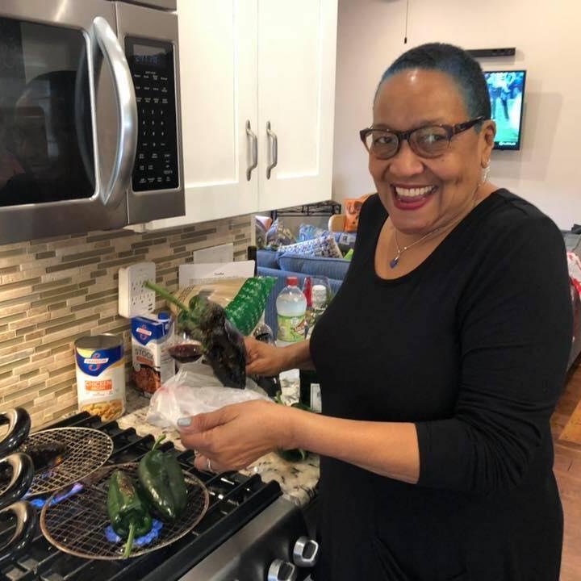
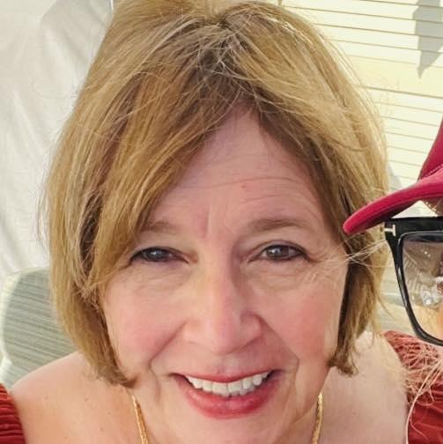
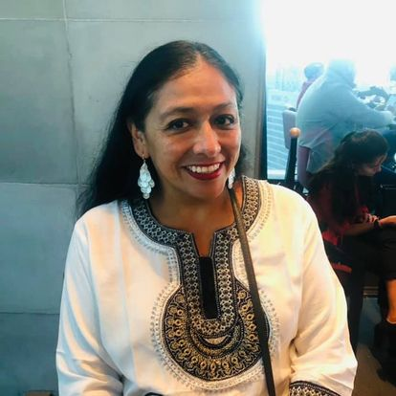
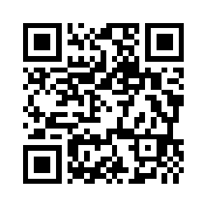
MEET OUR TEAM
Cathy Caplener
Arnette Travis
Roxanne Mulligan
Lisa Gonzalez
Founder, Chief Executive Officer
Secretary
Secretary
Chief Financial Officer
CONTACT
Cathy@GivingPurpose.Org
310-938-3158

Slide 14
THANK YOU!

Slide 15
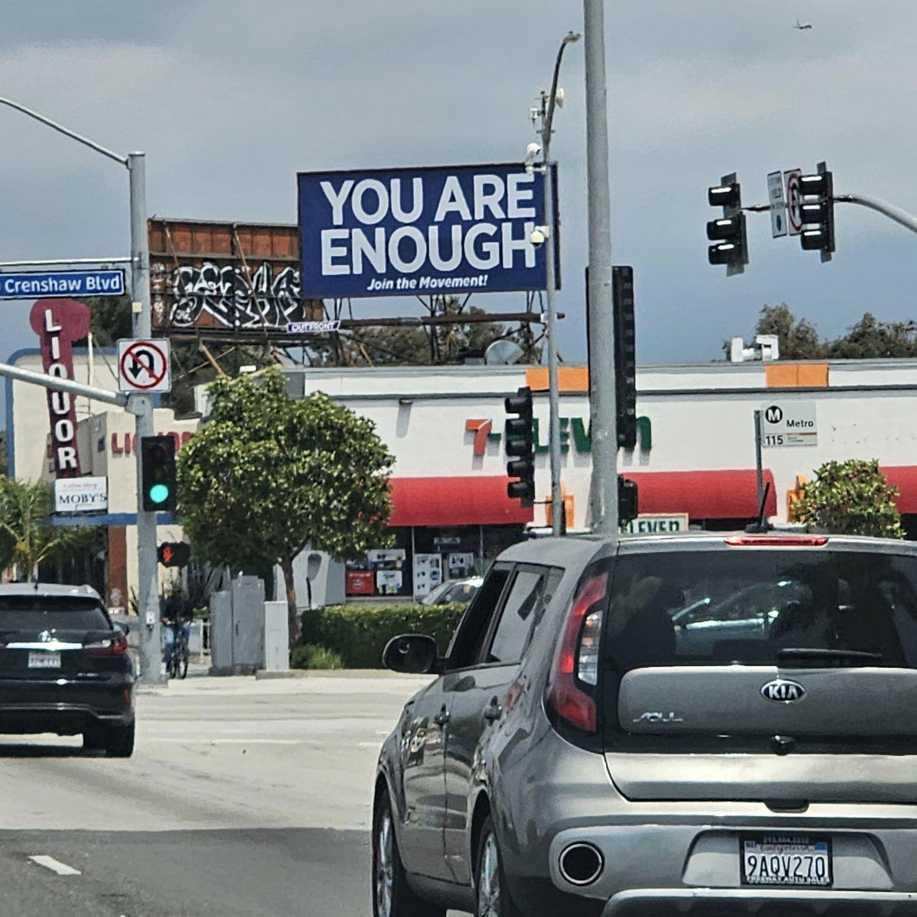
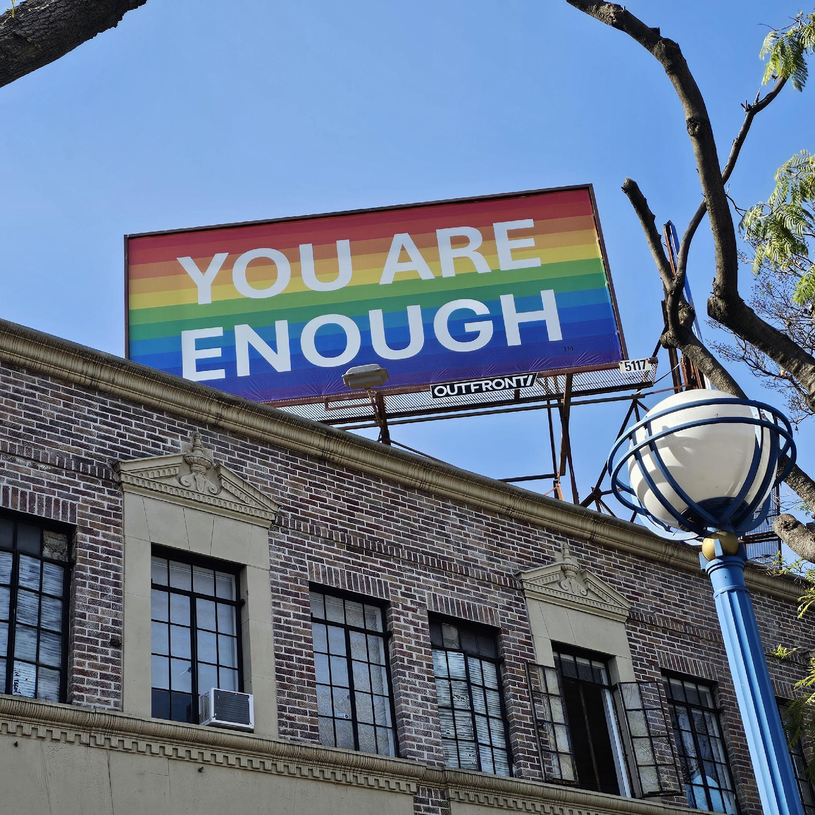
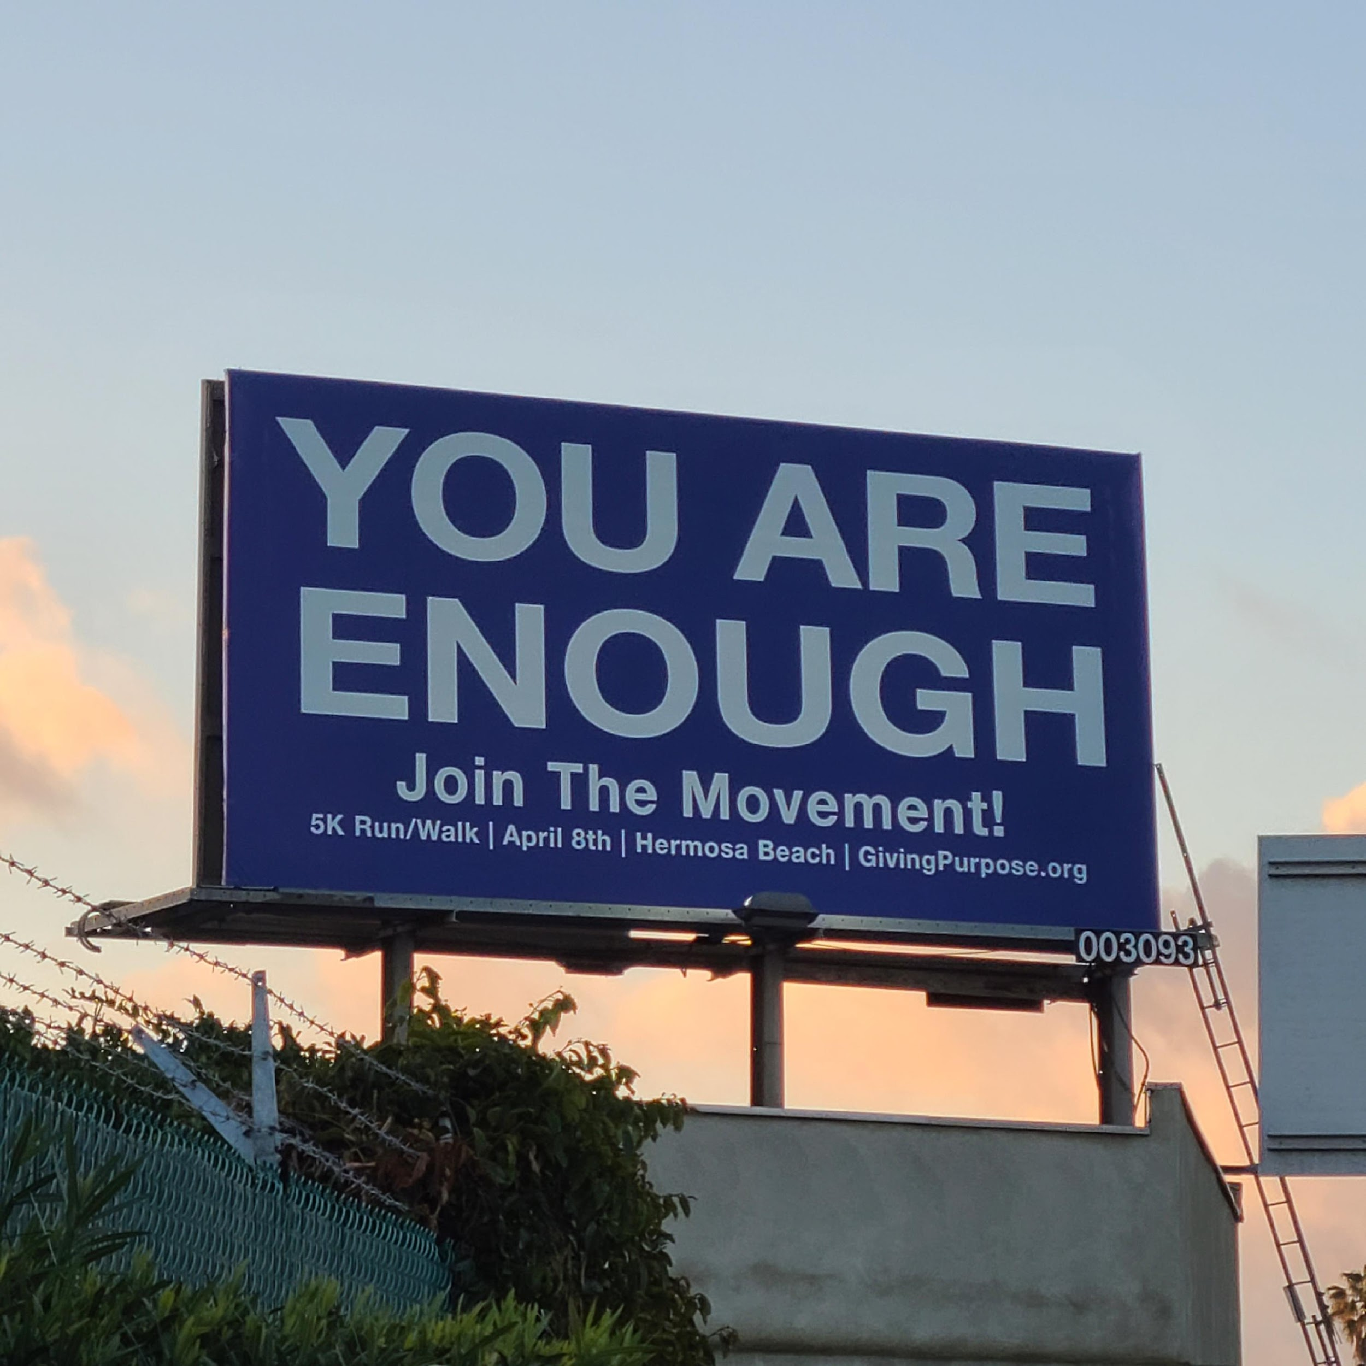
BILLBOARD DEMOGRAPHICS

Slide 16
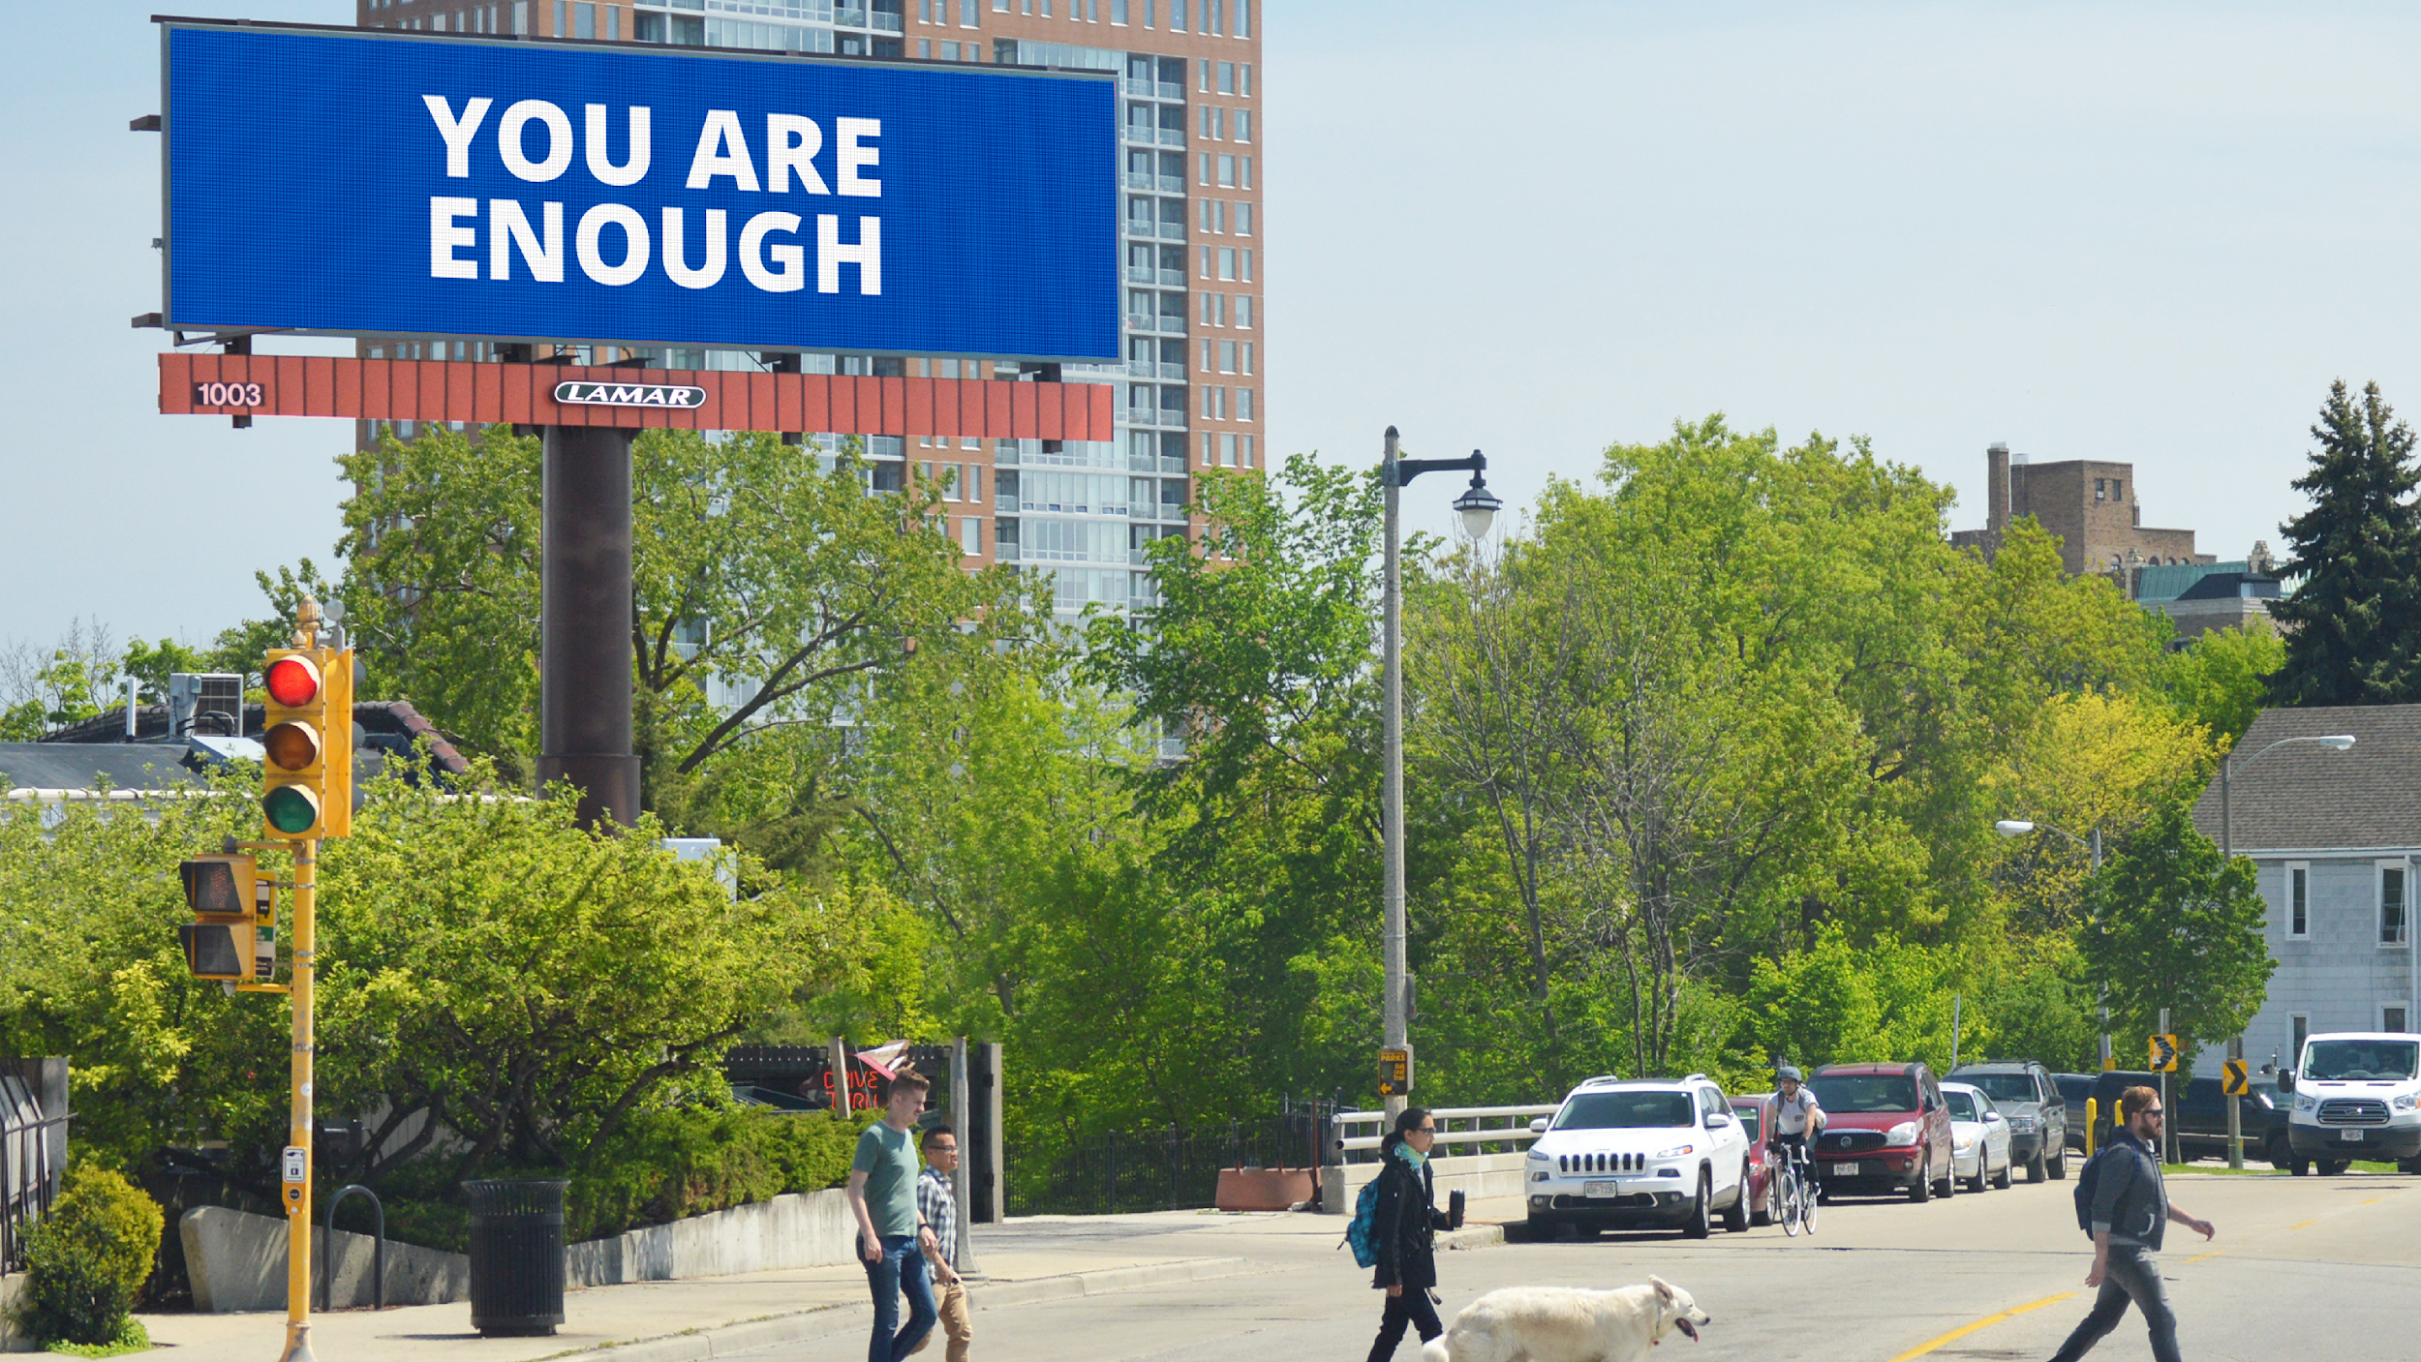
LAMAR ADVERTISING
NATIONWIDE Public Service Announcement Campaign – May Mental Health Awareness Month 2023, 2024
Number of markets: 73
Number of digital billboards: 1500
Number of impressions: 109M
Approx dollar value of donation: $544,000.00

Slide 17
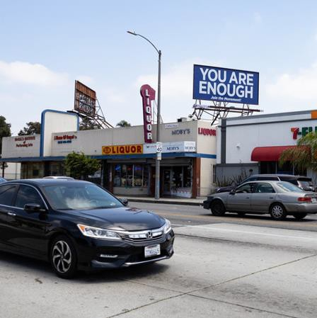
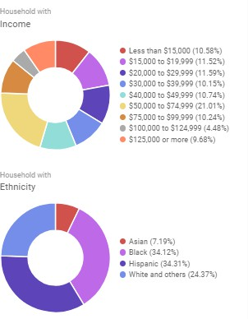
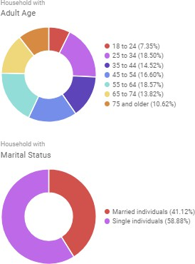
3845P Inglewood – Manchester and Century Blvd. – South Bay
Adults 18+ Weekly Impressions: 240,395

Slide 18
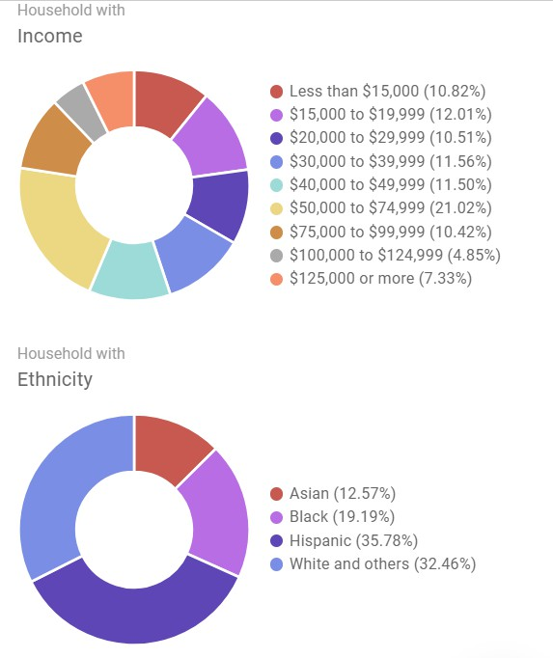
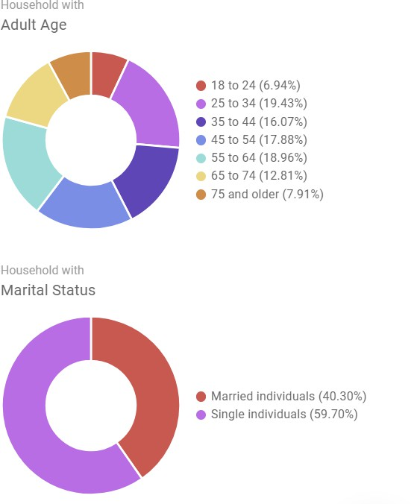
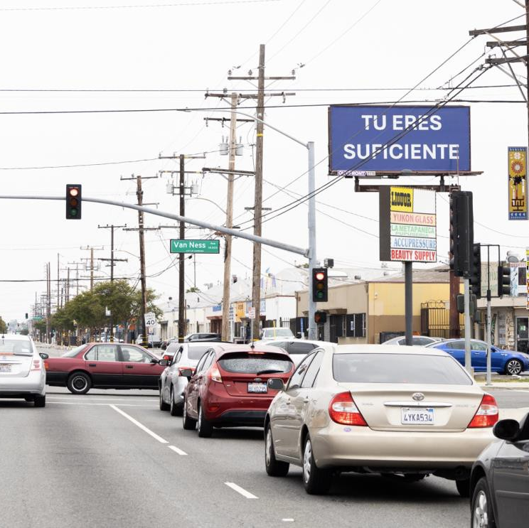
2779P ROSECRANS & VAN NESS SE – Gardena – South Bay
Adults 18+ Weekly Impressions: 230,328

Slide 19
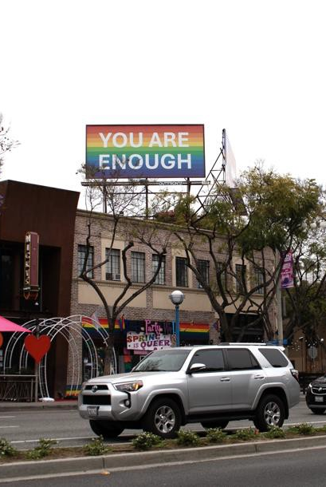
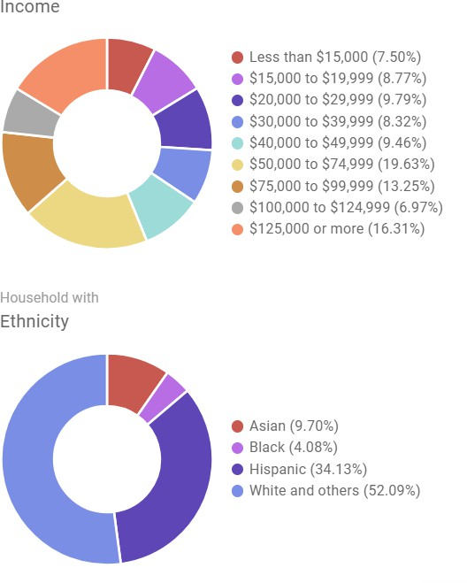
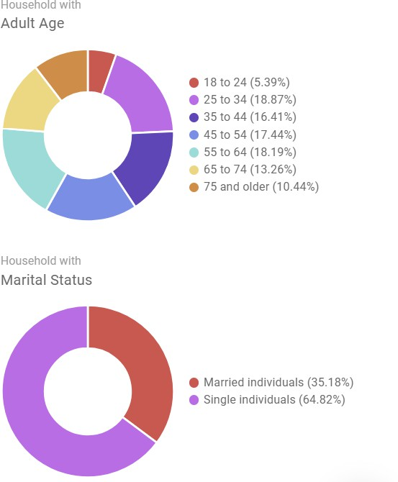
5117P SANTA MONICA & LARRABEE NW West Hollywood
Adults 18+ Weekly Impressions: 192,578

Slide 20
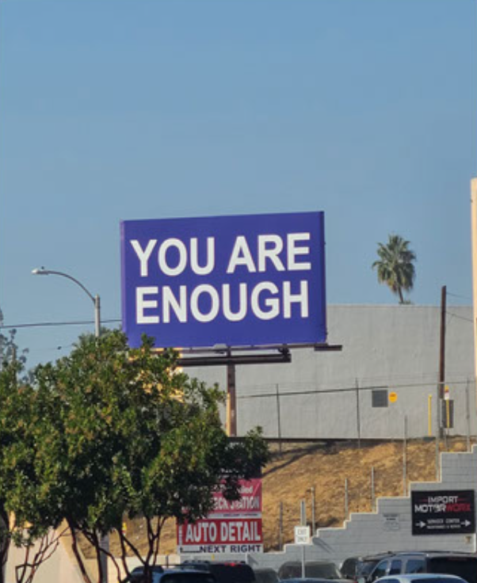
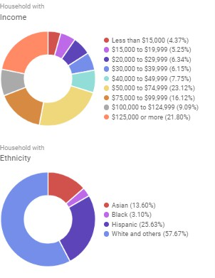
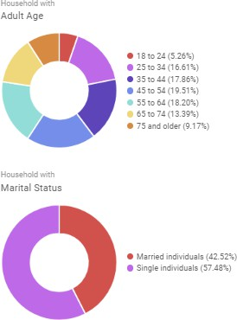
2794P ARTESIA BLVD & PERKINS NE
Redondo Beach
Adults 18+ Weekly Impressions: 159,815

Slide 21
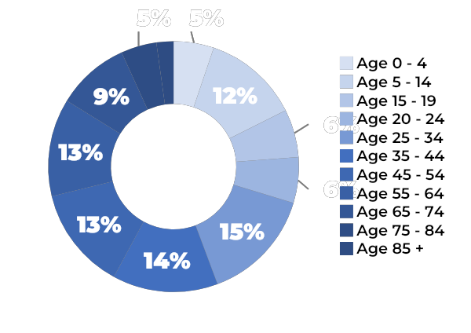
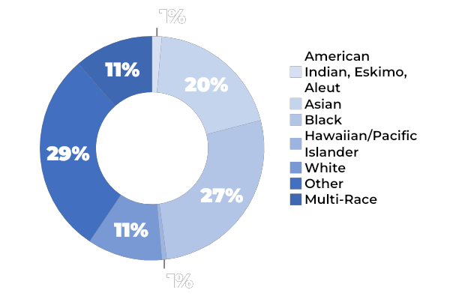
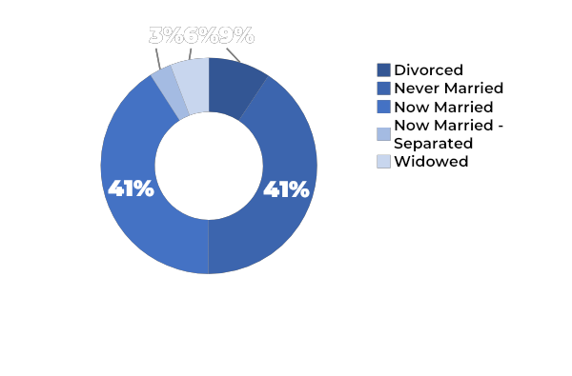
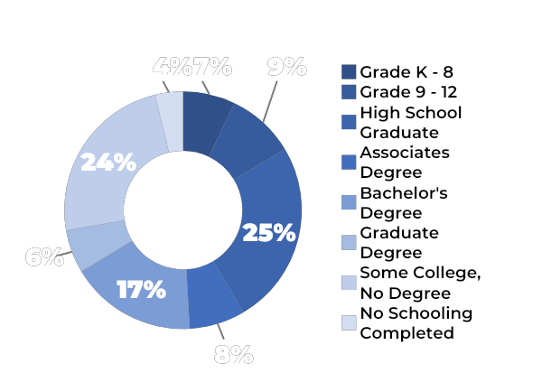
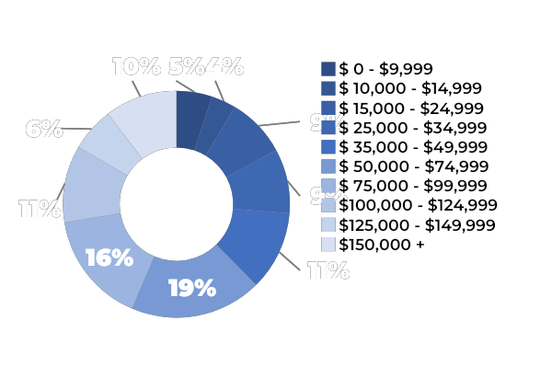
2023 DEMOGRAPHICS: Hawthorne Blvd - Torrance 6306
Age
Race And Ethnicity
Marital Status
Educational Attainment
Household Income

Slide 22
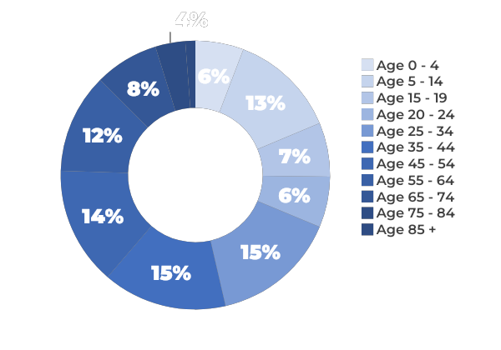
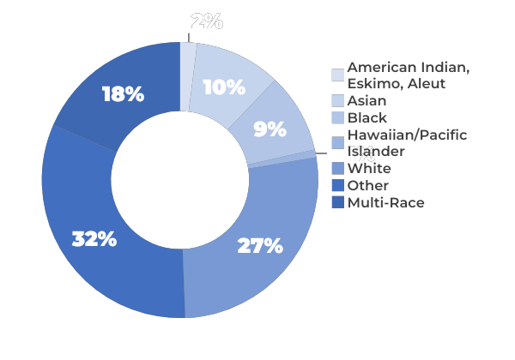
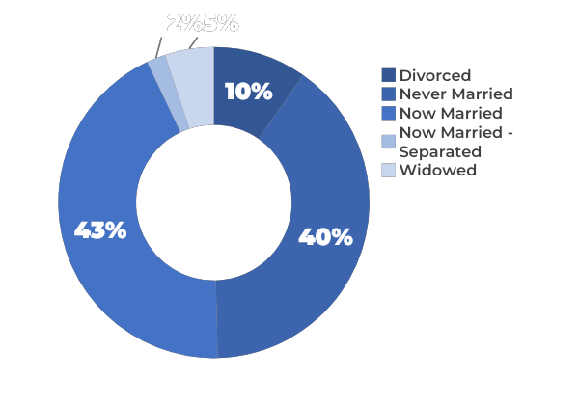
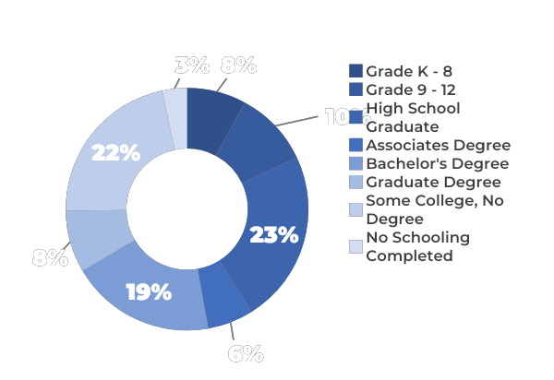
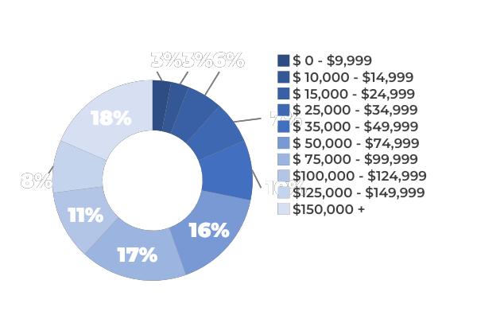
2023 DEMOGRAPHICS: Inglewood 3253
Age
Race And Ethnicity
Marital Status
Educational Attainment
Household Income

Slide 23
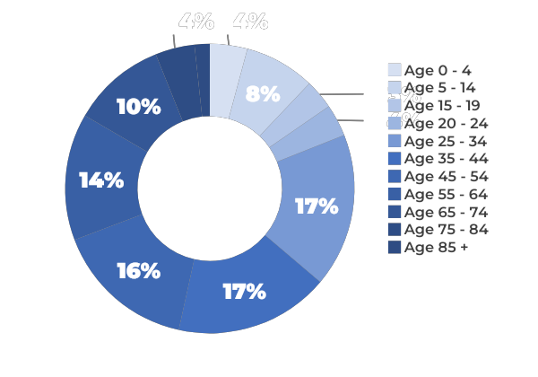
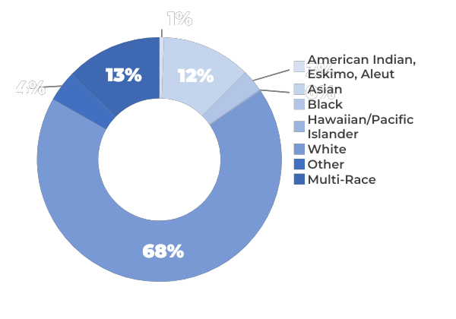
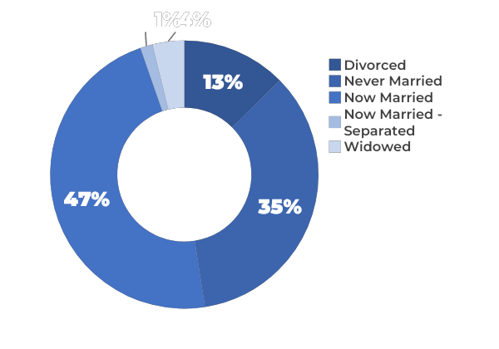
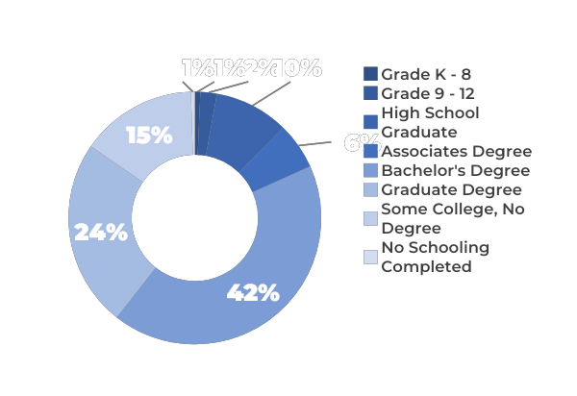
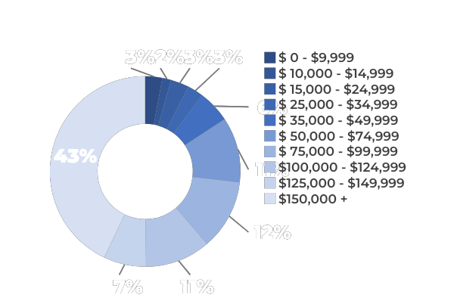
2023 DEMOGRAPHICS: Redondo Beach 3093
Age
Race And Ethnicity
Marital Status
Educational Attainment
Household Income

Slide 24
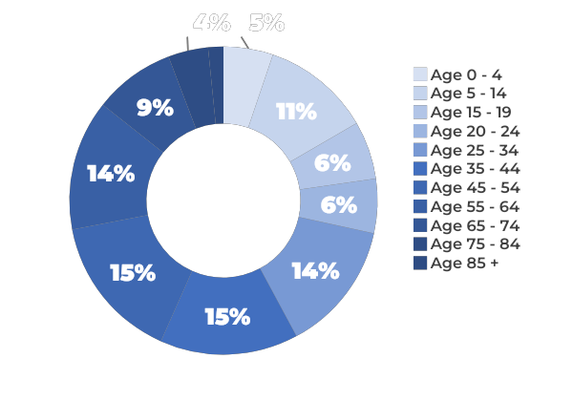
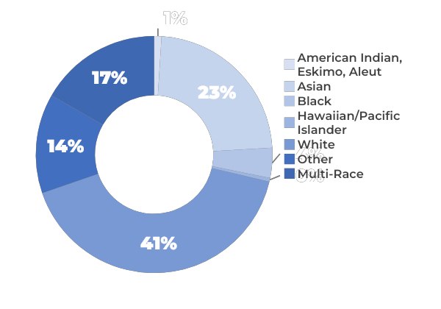
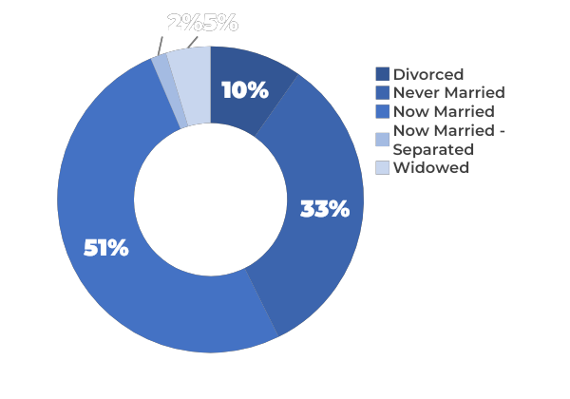
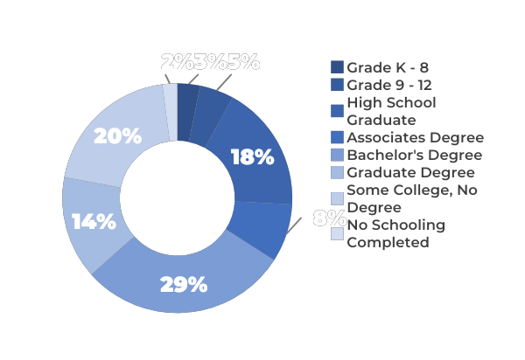
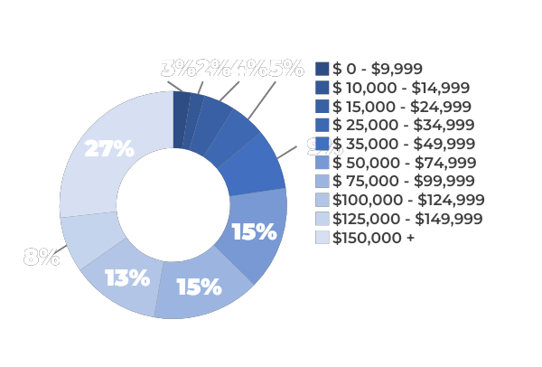
2023 DEMOGRAPHICS: Torrance 2776
Age
Race And Ethnicity
Marital Status
Educational Attainment
Household Income

Slide 25
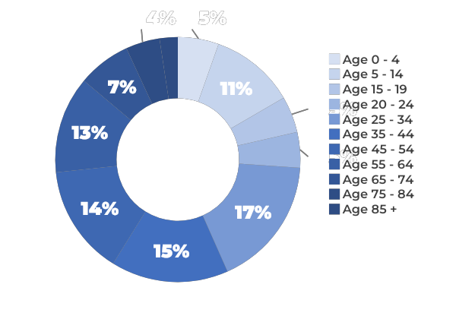
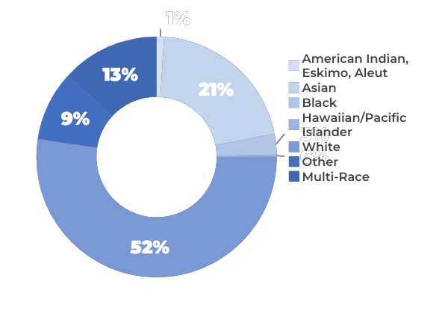

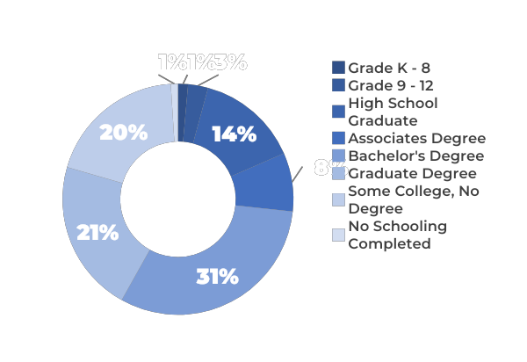

2023 DEMOGRAPHICS: Hermosa Beach 2692
Age
Race And Ethnicity
Marital Status
Educational Attainment
Household Income

